Slide 1
Lab 9: Elevator project, Composite pattern and abstract factory

Slide 2
Elevator project
Single Elevator System: Simulate a single elevator moving between floors numbered from 1 (lowest) to K (highest), starting at floor 1.
User Requests: Users can make requests via buttons located inside the elevator (one for each floor) or outside (UP and DOWN buttons). Requests are queued and cannot be canceled.
Request Handling:
The elevator moves immediately to address new requests if it’s idle, or it continues in its current direction until no requests remain.
If multiple requests are made simultaneously, the elevator prioritizes the nearest floor, favoring upward movement in case of ties.
All users waiting at a stop automatically board the elevator, regardless of direction, and select their destination.
Movement Timing:
Moving between floors takes 1 time unit, and stops for loading/unloading take 1 time unit.
Requests are made at whole time units, and the elevator responds immediately if it's at the requested floor.
Metrics to Track:
Track passenger arrival times (when the elevator reaches their destination).
Track the elevator's current floor at any time during the simulation.

Slide 3
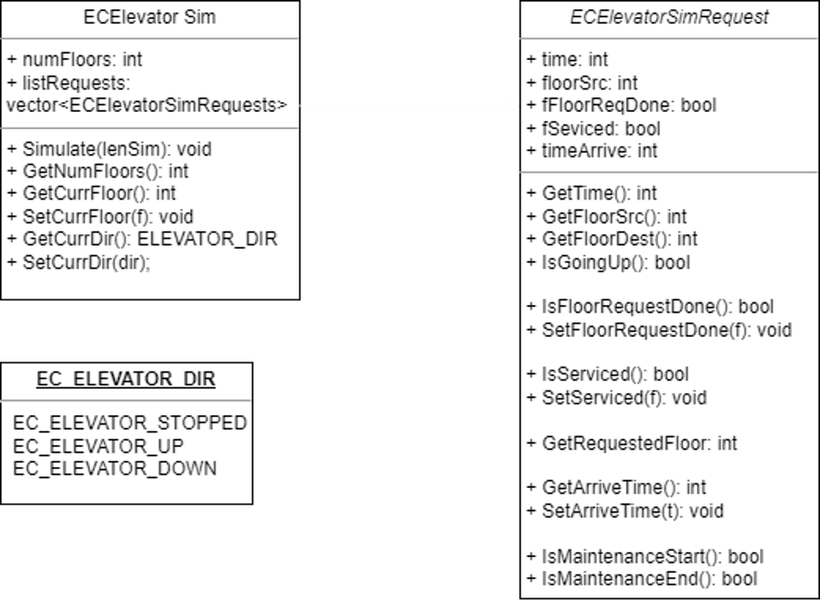
Starter Code Diagram

Slide 4
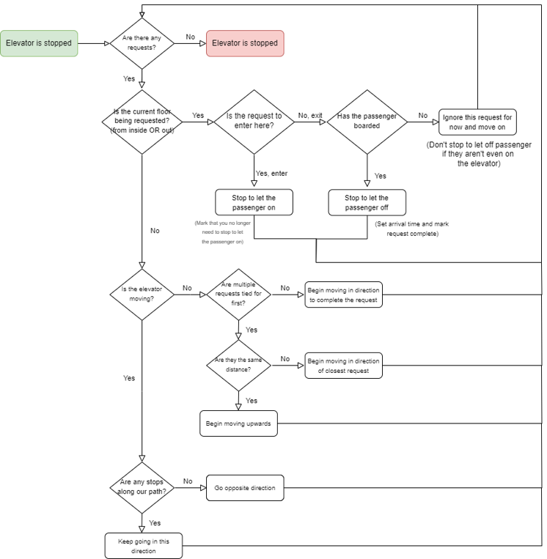
Logical Flow Diagram of Elevator Operation

Slide 5
Grading Criteria
No long functions. You will lose points if your code has a function that is longer than 100 lines of code (when formatted in the common way, e.g., one statement per line; properly commented; etc).
No complex loops (e.g., nested loops and/or complex loop breaking conditions). Complex loops are difficult to debug and maintain. Try to avoid such complex code by re-factoring your code. We will use cyclomatic complexity tests to evaluate your code.
No long chained conditional statements. Long chained conditional statements usually indicate a poor design from object orientation perspective. If you find yourself writing such complex code, it is time to consider re-factor your code. I would suggest using virtual functions: when used properly, virtual functions can simplify code structure. We will use cyclomatic complexity to measure the complexity of your code.
You should use multiple classes which include base classes and sub-classes. That is, you must use inheritance in some way.
You must use “virtual” functions.
You need to use at least one pure virtual function. This is to let you practice this key C++

Slide 6
Breaking Down Test2()
Passenger 1:
Requests at t = 2
Is at floor 4
Wants to go to 1
Elevator Sim Execution:​
t = 0, f = 1: No requests, remain stopped.​
t = 1, f = 1: No requests, remain stopped.​
t = 2, f = 1: Receive request to go pick up at 4 and bring to 1​
t = 3, f = 2: Moving to 4 to pick up p1, Request to go pick up at 5 and bring to 2​
t = 4, f = 3: Moving to 4 to pick up p1​
t = 5, f = 4: Pick up p1 (we can’t move and pick up in one turn)​
t = 6, f = 4: Move to 5 to pick up p2​
(Note that we prioritized moving in the same direction to get p2 before turning around)​
t = 7, f = 5: Pick up p2​
t = 8, f = 5: Move down to 4 to drop off p1,p2​
t = 9, f = 4: Move to 3​
t = 10, f = 3: Move to 2​
t = 11, f = 2: Drop off p2 (even though p1 requested first, we drop off p2 first because they are on the way)​
t = 12, f = 2: Move to 1​
t = 13, f = 1: Drop off p1​
t= 14, f = 1: No requests, remain stopped.​
…​
​
​
​
​
Passenger 2:
Requests at t = 3
Is at floor 5
Wants to go to 2

Slide 7
Breaking down 5_passenger_test_2
Passenger 1:
t = 1
Source floor = 3
Destination = 1
Passenger 2:
t = 2
Source floor = 3
Destination = 2
Passenger 3:
t = 10
Source floor = 2
Destination = 3
Passenger 4:
t = 14
Source floor = 2
Destination = 1
Passenger 5:
t = 20
Source floor = 3
Destination = 2
t=0,f=1: No request, waiting
t=1,f=1: Request from p1 received moving up towards 3
t=2,f=2: Move to 3, request from p2 received
t=3,f=3: Pick up p1 and p2
t=4,f=3: Move to 2
t=5,f=2: Drop off p2
t=6,f=2: Move to 1
t=7,f=1: Drop off p1
t=8,f=1: No requests, stopped
t=9,f=1: No requests, stopped
t=10,f=1: Request from p3 moving up towards 2
t=11,f=2: Pick up p3
t=12,f=2: Move to 3
t=13,f=3: Drop off p3
t=14,f=3: Request received from p4, moving down to 2
t=15,f=2: Pick up p4
t=16,f=2: Move to 1
t=17,f=1: Drop off p4
t=18,f=1: No requests, stopped
t=19,f=1: No requests, stopped
t=20,f=1: Request from p5, moving up towards 5
t=21,f=2: Move to 3
t=22,f=3: Pick up p5
t=23,f=3: Move down towards 2
t=24,f=2: Drop off p5
t=25,f=2: No requests, stopped
t=26,f=2: No requests, stopped
…

Slide 8
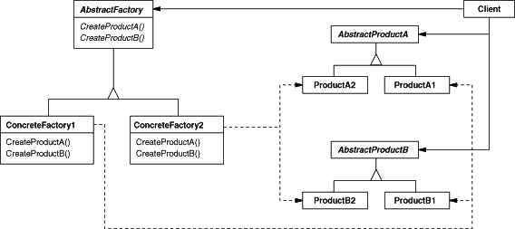
Abstract Factory - Creational design pattern
Abstract Factory is a creational design pattern that lets you produce families of related objects without specifying their concrete classes.

Slide 9
Why use Abstract Factory?
Problem: Imagine we’re creating a document editor, and our code consists of classes that represent:
A family of related document elements: for instance, Paragraph, Image, and Table.
Several variants of this family: for example, elements like Paragraph, Image, and Table are available in different styles, such as PlainText, RichText, or Graphic.
We need a way to create individual document elements so that they match other elements within the same style family. We want to avoid modifying existing code whenever a new document element or style family is introduced to the editor. Document formatting standards and styles can change frequently, and updating the core code each time would be time-consuming and risky.
// Abstract Classes of components
class Text : public DocumentComponent {
};
class Image : public DocumentComponent {
};
class Table : public DocumentComponent {
};

Slide 10
Solution
// Abstract Factory
class ComponentFactory {
public:
virtual ~ComponentFactory() = default;
virtual DocumentComponent* createText() = 0;
virtual DocumentComponent* createImage() = 0;
virtual DocumentComponent* createTable() = 0;
};
// Concrete Factory
class PlainComponentFactory : public ComponentFactory {
};
class RichComponentFactory : public ComponentFactory {
};
Define an interface for each distinct type of document element (e.g., Paragraph, Image, Table, etc.).
Create variants of these elements for each style family. For instance, a RichText style would have RichTextParagraph, RichTextImage, and RichTextTable, while a PlainText style would provide PlainTextParagraph, PlainTextImage, and PlainTextTable.
Implement an Abstract Factory—an interface that includes a set of creation methods for all document elements in the style family (e.g., createParagraph, createImage, and createTable). These methods should return abstract element types represented by the interfaces we defined earlier: Paragraph, Image, Table. This setup enables easy addition of new element styles or types without changing the existing code structure.

Slide 11
How does the client interact with abstract objects?
// Concrete document elements
DocumentComponent* PlainComponentFactory::createText() {
}
DocumentComponent* PlainComponentFactory::createImage() {
}
DocumentComponent* PlainComponentFactory::createTable() {
}
4) Concrete Factories implement the creation methods of the abstract factory. Each concrete factory corresponds to a specific style family of document elements, such as RichTextFactory or PlainTextFactory. For instance, RichTextFactory would create and return RichTextParagraph, RichTextImage, and RichTextTable elements, while PlainTextFactory would provide PlainTextParagraph, PlainTextImage, and PlainTextTable.
5) The client holds a pointer or reference to the abstract factory, which could be any of the specific style factories we’ve implemented. This way, the client code that uses the factory doesn’t become dependent on a specific style family of document elements. The client can work with any concrete factory and element style as long as it communicates with their elements via abstract interfaces. This flexibility allows the client to easily switch between different document styles (e.g., from plain text to rich text) without altering the core code structure.

